Slide 1
Bootstrap Components and UI Kits
L05 – Story Teller II
C273 – Advanced Web Application Development in PHP

Slide 2
Today's problem
Further improve the look and feel of Story Teller II website by using Bootstrap 4 components.

Slide 3
21 Bootstrap Components
Alerts
Badge
Breadcrumb
Buttons
Button Group
Card
Carousel
Collapse
Dropdowns
Forms
Input Group
Jumbotron
List group
Modal
Navs
Navbar
Pagination
Popovers
Progress
Scrollspy
Tooltips
Include jQuery (necessary for Bootstrap's JavaScript plugins)
<script src="js/jquery-3.4.1.min.js" type="text/javascript"></script>

Slide 4
jQuery file
Many of Bootstrap plugins require a jQuery file, so you need to add this line in your html file
<script src="js/jquery-3.4.1.min.js" type="text/javascript"></script>

Slide 5
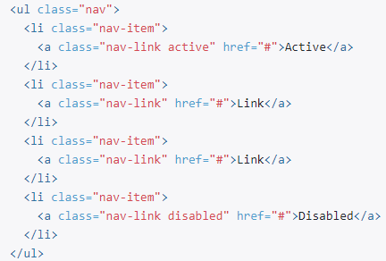
Navs

Slide 6



Navs

Slide 7
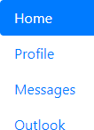
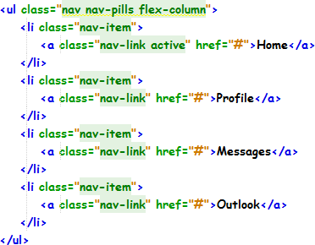
Exercise 1: Solution

Slide 8

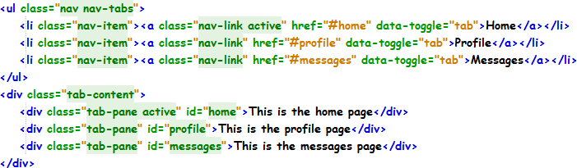
Exercise 2: Solution

Slide 9
Navbar #1

Slide 10
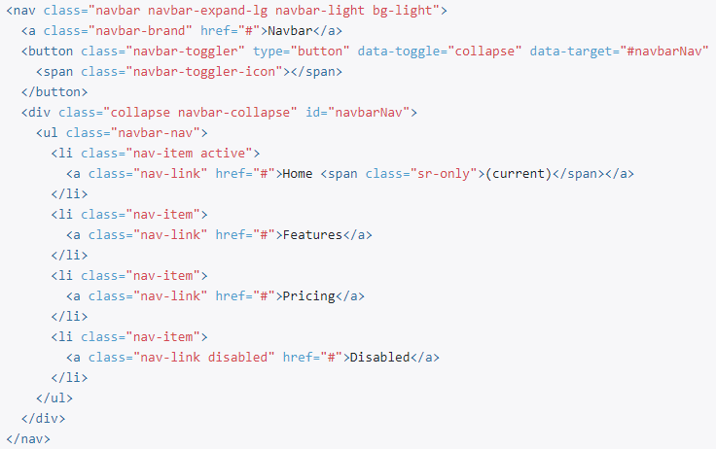
Navbar

Slide 11
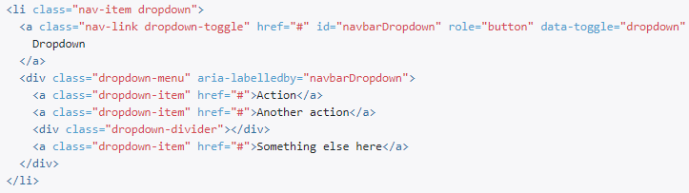
Navbar
Dropdown menu

Slide 12
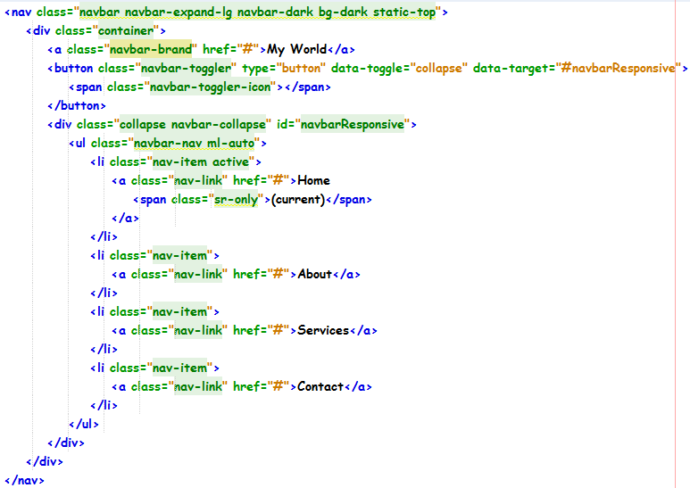
Exercise 3: Solution

Slide 13
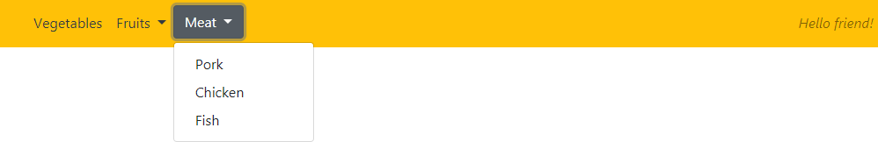
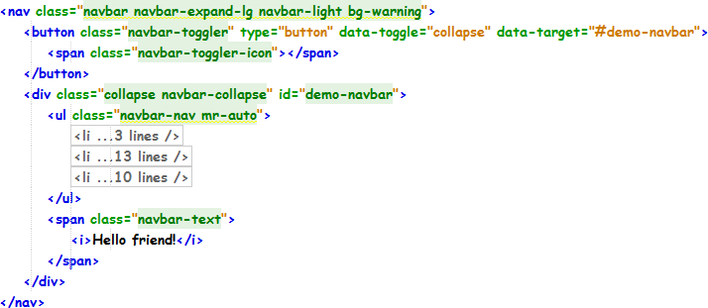
Exercise 4: Solution
Contents within the <ul></ul> element is in the next slide

Slide 14
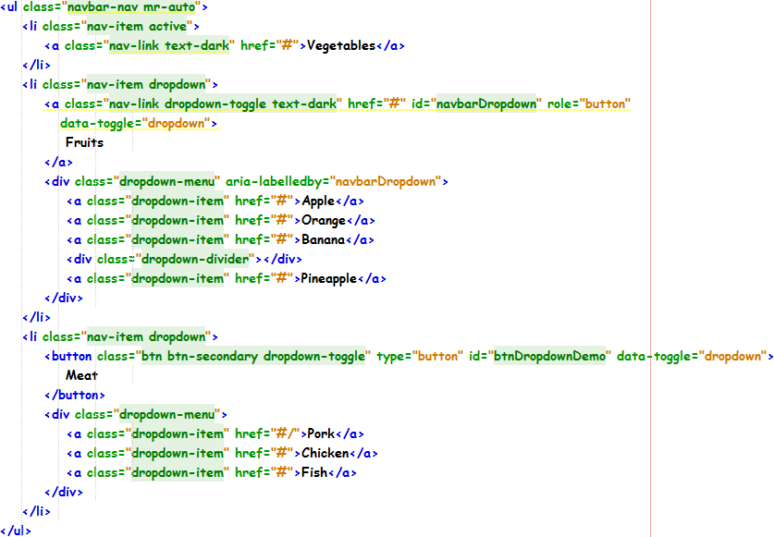
Exercise 4: Solution

Slide 15

Carousel
The Bootstrap carousel is a flexible, responsive way to add a slider to your site.
Allow images, iframes, videos, etc.

Slide 16
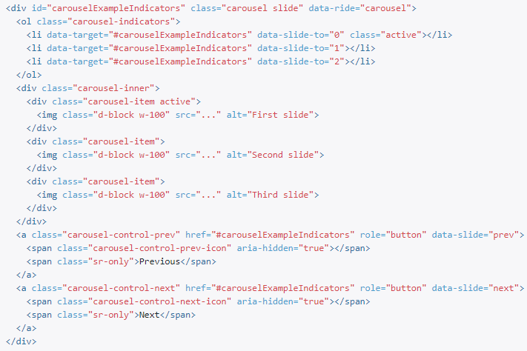
Carousel

Slide 17
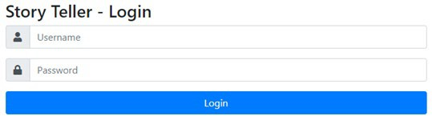
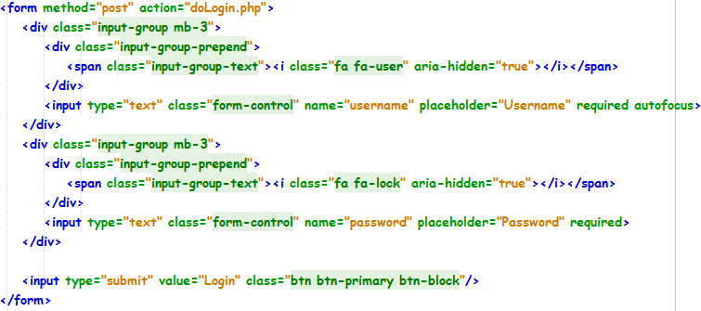
login.php

Slide 18
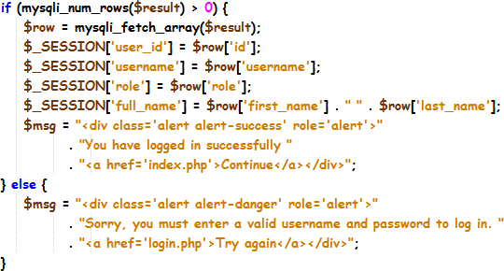
doLogin.php

Slide 19
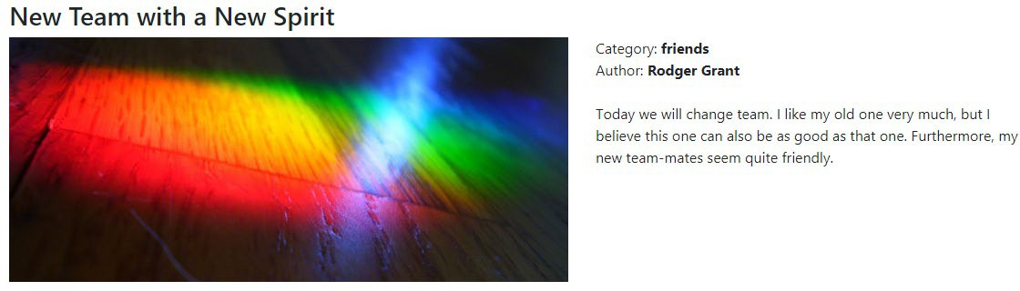
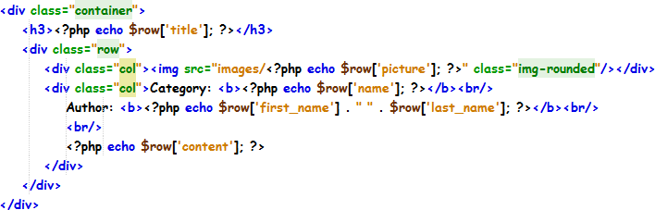
storyDetails.php

Slide 20
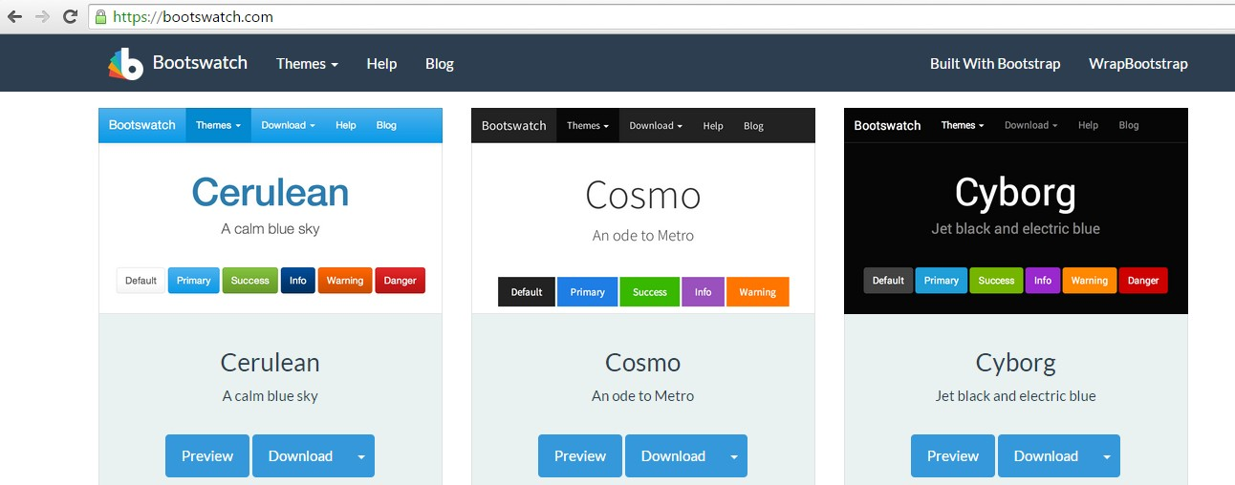
Choose and download themes
bootswatch.com
Download the theme template that you want

Slide 21
What you learnt today
Apply Bootstrap components like Navs, Navbar, Alerts, Input Group, Breadcrumbs and Carousel to build web pages.
Use various Bootstrap UI Kits like Bootswatchr and Bootswatch to customize themes and templates.

